Slide 1
Individual Study Report
20220827 Wenqu Fang

Slide 2
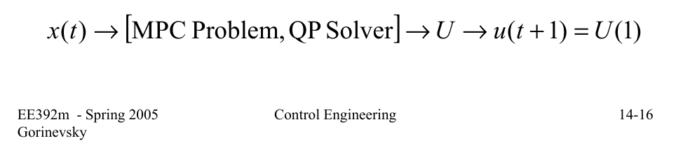
MPC: Model Predictive Control
Optimal control
Given plant states at t, cost function, and constraints, compute control inputs in [t, t+nT] (prediction horizon of n time steps) such that the constraints are satisfied and the cost is minimized (CppAD::ipopt::solve)
Tradeoff between computational cost and efficiency
Fine-tuning coefficients, adjusting time steps or n, etc.

Slide 3
Definition & Purpose
Waypoint: location
On the smart city platform: waypoints are a reference path for cars, to be used by MPC algorithm in its cost function
Additional specifications:
All of the available paths covered
No change of lanes is required
As few segments as possible
Path should be in a specified .json format

Slide 4
Idea
Graph approach: (graph theory)
Nodes (minimum): points where there are more than one incoming direction / more than one outgoing direction
For convenience of development: all start of turns and end of turns

Slide 5
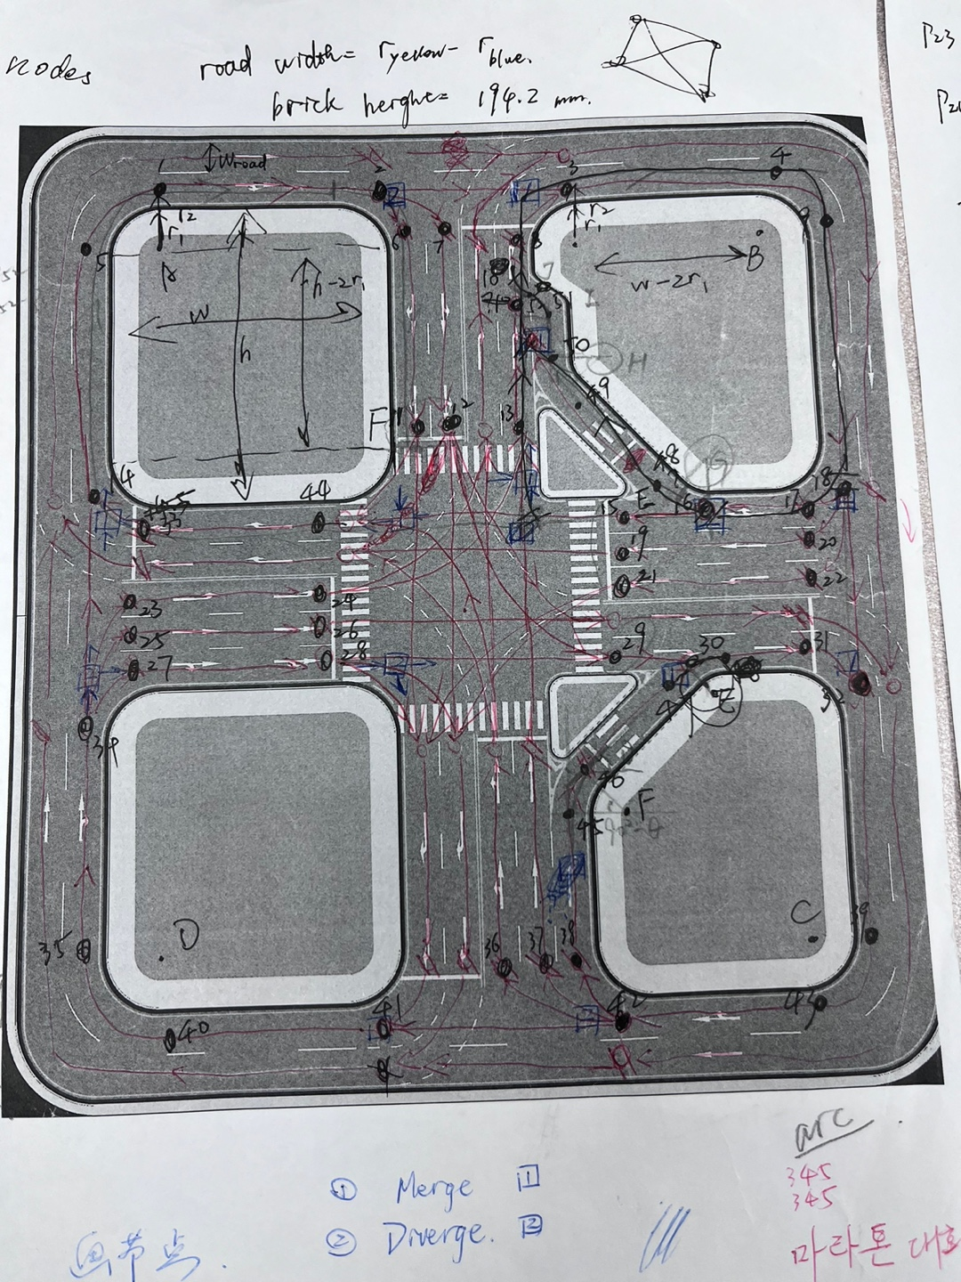

Slide 6
Implementation
nodes: obtained from measurement on MS powerpoint (lines, circles)
get_straight_seg, get_ellipse_seg: given input nodes, output straight line path / elliptical section path (at regular 90° turns)
Only start and end nodes’ coordinates and clockwise/anticlockwise orientation to be supplied. No need to treat different corners individually.

Slide 7
Implementation
get_seg: API of two functions above. Node index and line type (and orientation) as input. Output a .json file for the waypoints.
seg_dict: stores all segment arrays in a dictionary.
{(node pair tuple): [segment np.ndarray]}
get_segs: API for using multiple get_seg easily. Sampling distance can be set.
get_path: API for generating paths in .json format, connecting segments created earlier.

Slide 8
Implementation
Ultimate effect
To generate straight lines and regular turns, simply put an additional tuple in the “info” variable,
Specifying start node index, end node index, type (“straight” or “turn”), and orientation (“clockwise”, “anticlockwise”, or None)
Irregular turns (right turn): ground-up.
Tests and exception catching
See function docstrings for more explanation

Slide 9
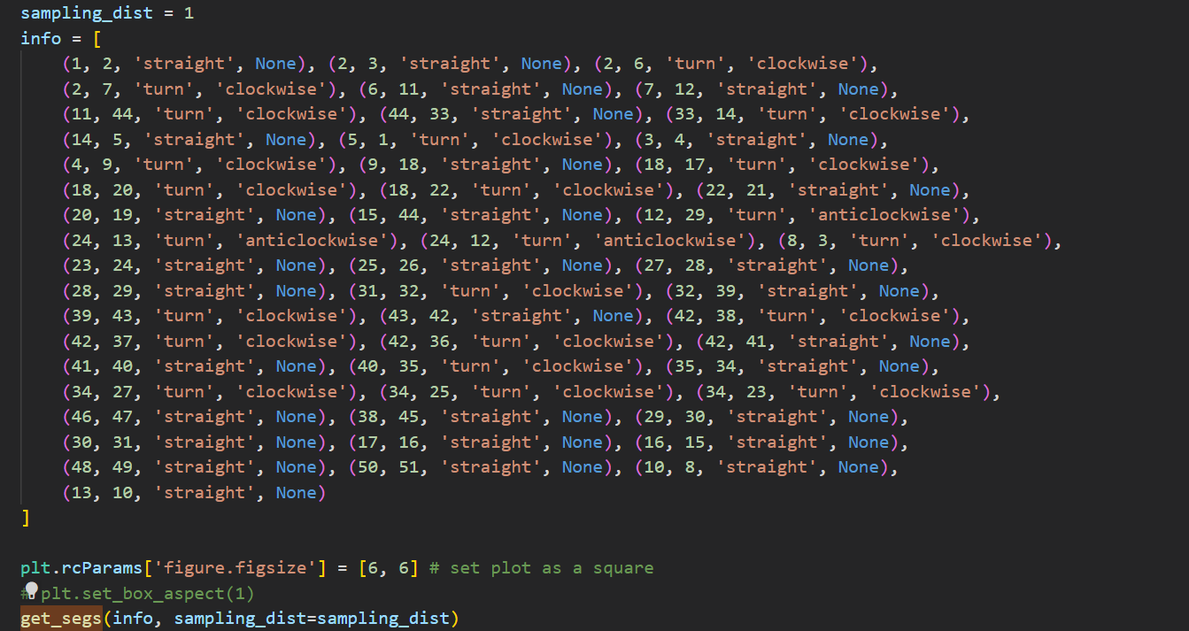

Slide 10
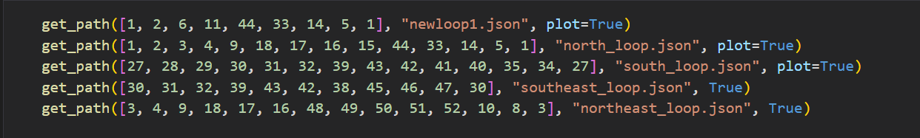

Slide 11
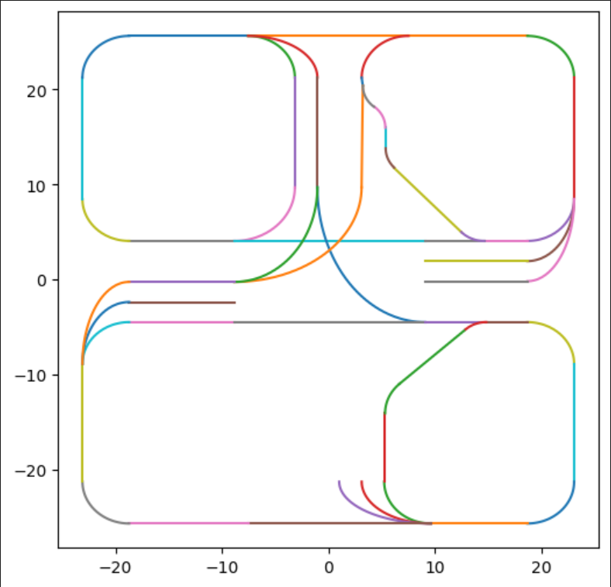
Tests
matplotlib.pyplot is used to test individual functions and overall implementation
Paths are then integrated to ros2 project and tested on testbed.

Slide 12
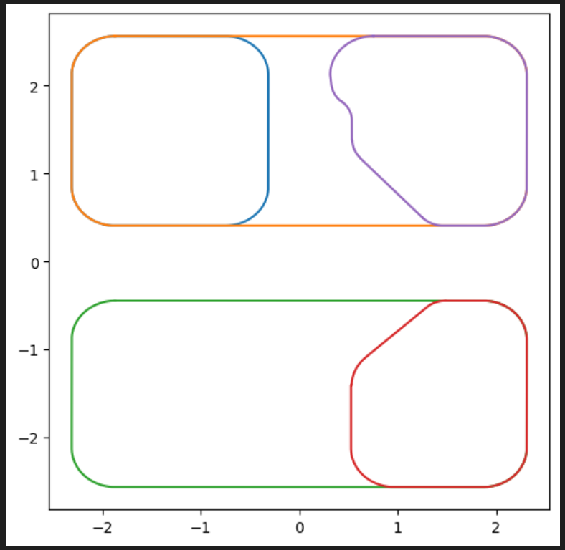

Slide 13
Analysis of Test Results
plt tests look all right.
Cars running on the testbed:
error in node detected, corrected.
Unexplained behavior of RC car, possibly for hardware problems
ros2_rviz: visualization tool. See if the local path matches the global path.

Slide 14
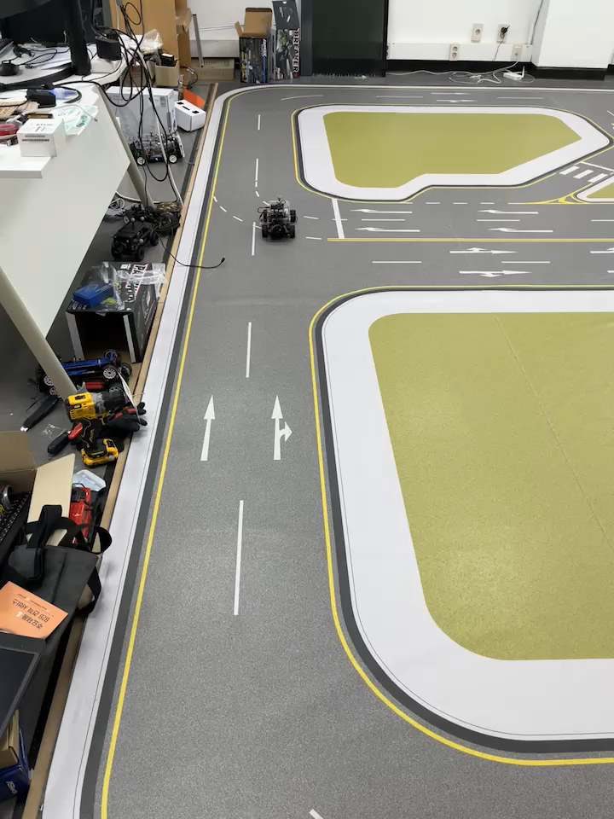

Slide 15
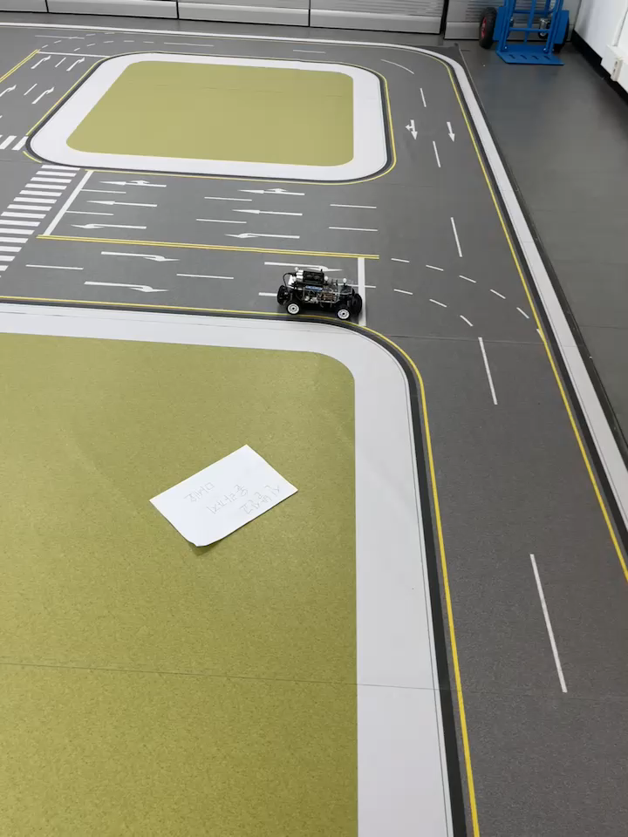

Slide 16
Possible Extension Work
Path planning: Dijkstra / A* / RRT (existing C++ code)
Online file i/o for path update: implementation in C++ (harder)/ program migrate to python script + calling Python/C API (easier)
https://docs.python.org/3/extending/embedding.html
More segments to be added.
Some segments may be merged into one to accelerate path planning

Slide 17
RC Car Restructuring: Expansion Board
Enabling CAN communication via STM32 microcontroller (C)
Motor & servo control implementation: migrate raspberry Pi code to new board (Python) (Jehyeop)

Slide 18
Thank You All!

